Slide 1
PWM
שליטה על רוחב פולס

Slide 3
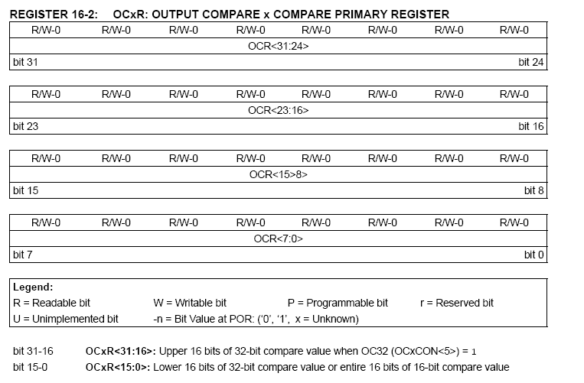

Slide 4
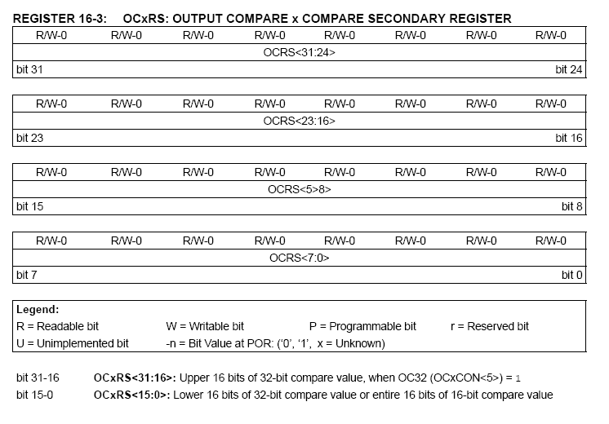

Slide 5
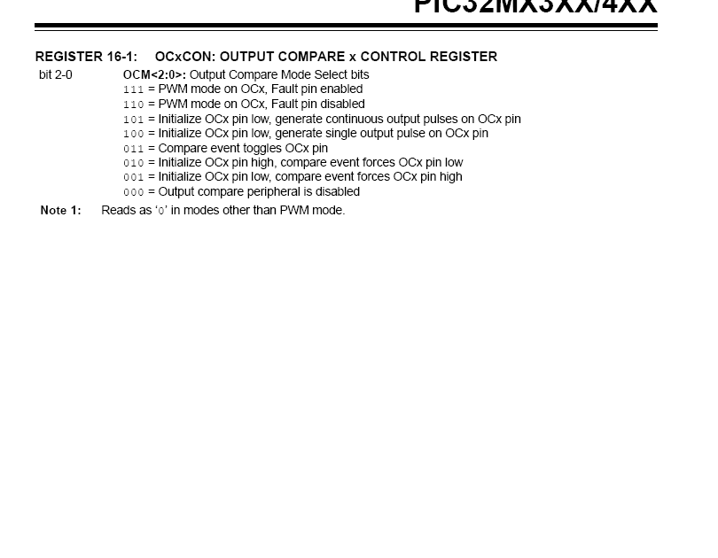

Slide 6
#include <p32xxxx.h>
#include <string.h>
//DEVCFG1 BOOT CONFIGURATION REGISTER
#pragma config POSCMOD = HS //Select primary osc.(8MHz)
#pragma config FPBDIV = DIV_8 //PBCLK is SYSCLK divided by 8 => PBCLK = 10MHz
#pragma config FNOSC = PRIPLL //Primary Oscillator with PLL (XTPLL, HSPLL, or ECPLL)
//DEVCFG2 BOOT CONFIGURATION REGISTER
#pragma config FPLLIDIV = DIV_2 //Default PLL Input Divider Value = 2 => SYSCLK = 4MHz
#pragma config FPLLMUL = MUL_20 //Default PLL Multiplier Value = 18 => SYCLK = 80MHz
#pragma config FPLLODIV = DIV_1 //Postscaler PLL output divided by 1
#pragma config FWDTEN = OFF //Watch-Dog Timer = OFF
#pragma config CP = OFF //Code Protect = OFF
#pragma config BWP = OFF //BOOT Write Protect = OFF
void pwm(unsigned int rate);
שינוי התדר בעזרת המפסקים

Slide 7
int main()
{
unsigned int x, i, j;
TRISD=0;
OC3CON = 0x05;
OC3R =0x4000;
OC3RS = 0xffff;
OC3CONbits.ON = 1;
T2CON = 0x08;
TMR2 = 0;
PR2 = 0xffff;
T2CONbits.ON = 1;
i = 0x8000;
while(1)
pwm(i);
}
void pwm(unsigned int rate)
{
int x;
TRISF=0;
TRISD=0;
TRISE=0xff;
PORTF=3;
PORTDbits.RD4=1;
PORTDbits.RD4=0;
x=PORTE;
TRISE=0;
PORTF=4;
PORTE=x;
PORTDbits.RD4=1;
PORTDbits.RD4=0;
PR2 = rate+(x*100);
OC3R =0x4000;
OC3RS = rate;
}

Slide 11
#include <p32xxxx.h>
#include <string.h>
//DEVCFG1 BOOT CONFIGURATION REGISTER
#pragma config POSCMOD = HS //Select primary osc.(8MHz)
#pragma config FPBDIV = DIV_8 //PBCLK is SYSCLK divided by 8 => PBCLK = 10MHz
#pragma config FNOSC = PRIPLL //Primary Oscillator with PLL (XTPLL, HSPLL, or ECPLL)
//DEVCFG2 BOOT CONFIGURATION REGISTER
#pragma config FPLLIDIV = DIV_2 //Default PLL Input Divider Value = 2 => SYSCLK = 4MHz
#pragma config FPLLMUL = MUL_20 //Default PLL Multiplier Value = 18 => SYCLK = 80MHz
#pragma config FPLLODIV = DIV_1 //Postscaler PLL output divided by 1
#pragma config FWDTEN = OFF //Watch-Dog Timer = OFF
#pragma config CP = OFF //Code Protect = OFF
#pragma config BWP = OFF //BOOT Write Protect = OFF
שליטה על מנוע מהירות וכיוון בעזרת שליטה על רוחב פולס
#1

Slide 12
void pwm(unsigned int rate);
int main()
{
unsigned i, j, x;
TRISD=0;
PORTDbits.RD3 = 0; // BRAKE(no)
PORTDbits.RD1 = 1; // Direction - FWD
OC3CON = 0x05;
OC3R = 0x50;
OC3RS = 0x1000;
OC3CONbits.ON = 1;
T2CON = 0x08;
TMR2 = 0x00;
PR2 = 0x1000;
T2CONbits.ON = 1;
TRISF=0;
TRISD=0;
#2

Slide 13
while (1)
{
TRISE = 0xff;
PORTF = 3;
PORTDbits.RD4 = 1;
PORTDbits.RD4 = 0;
x = PORTE;
if (x & 1)
PORTDbits.RD3 = 0;//BRAKE(no)
else
PORTDbits.RD3 = 1;//BRAKE
#3

Slide 14
if (x & 128)
PORTDbits.RD1 = 1; // שליטה על כיוון המנוע
else
PORTDbits.RD1 = 0; // Direction
TRISE = 0;
PORTF = 4;
x &= 0x81;
PORTE = x;
PORTDbits.RD4 = 1;
PORTDbits.RD4 = 0;
#4

Slide 15
i = 0x1000;
while (i < 0x10000)
{
pwm(i);i++;for (j = 0;j < 100;j++);
}
while (i > 0x70)
{
pwm(i);i--;for (j = 0;j < 100;j++);
}
}
}
void pwm(unsigned int rate)
{
PR2 = rate;
OC3RS = rate;
}
#5

